Slide 1
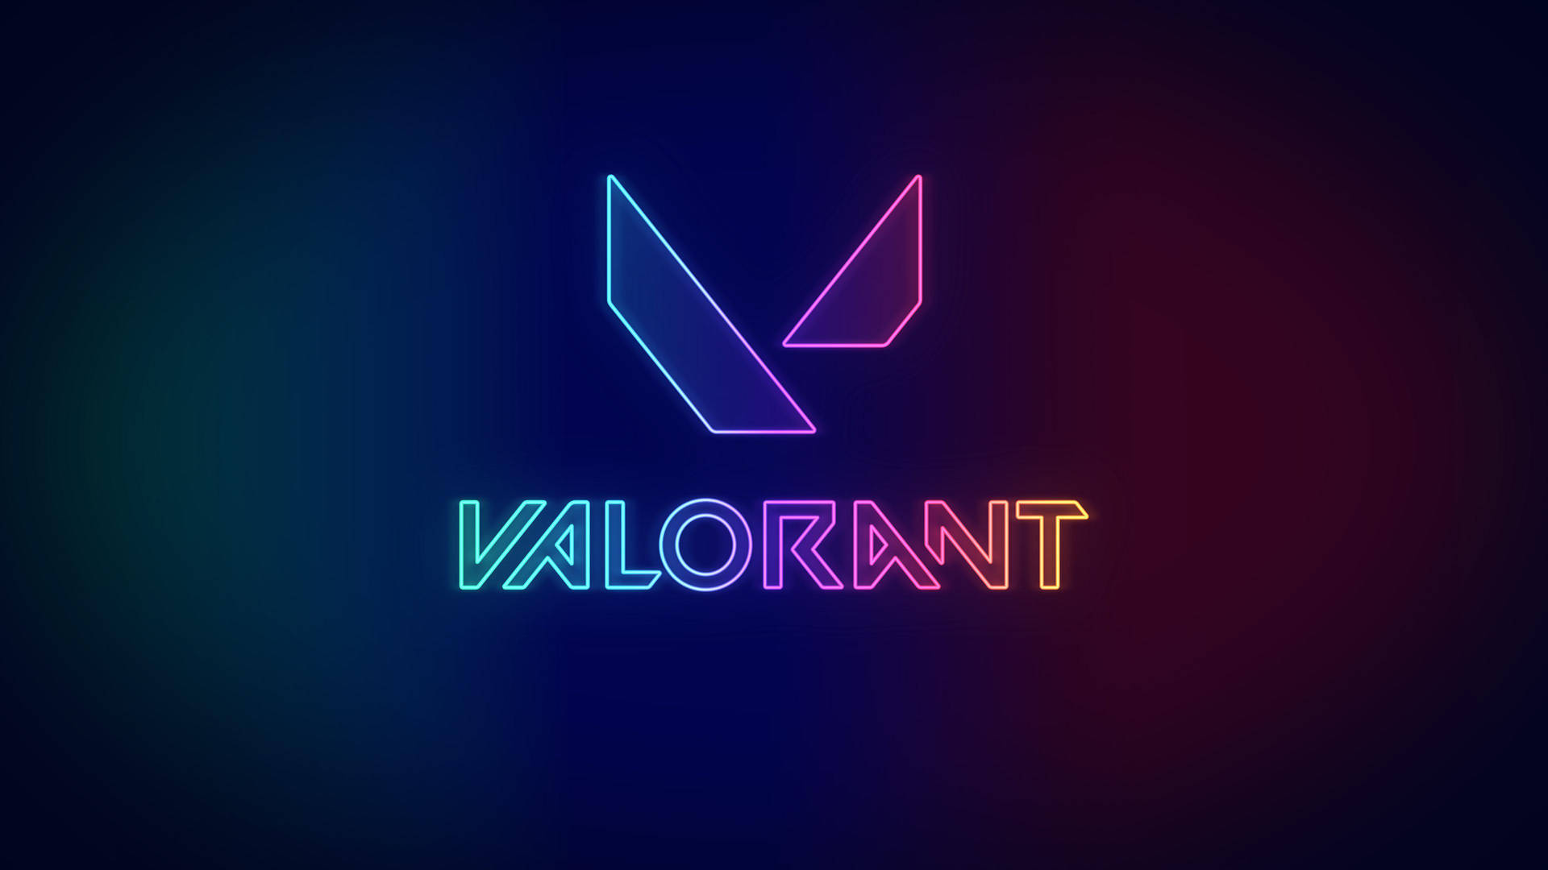

Slide 2

Valorant

Slide 3
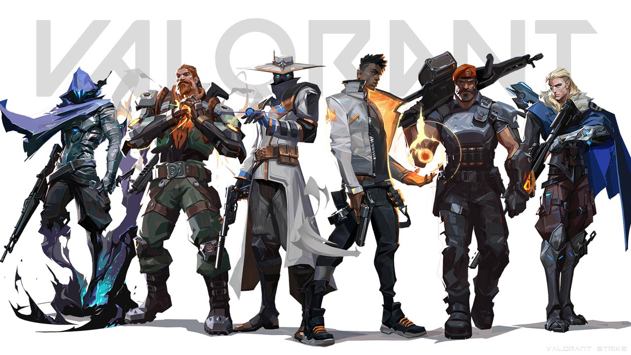

Slide 4
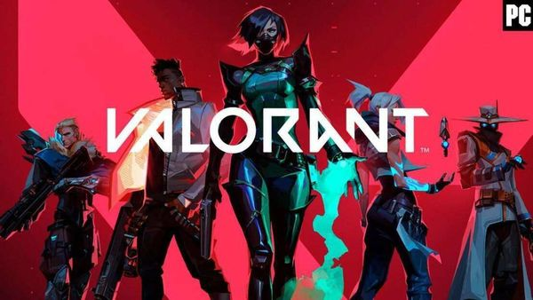
Introduction
Valorant is a 5v5 tactical first-person shooter (FPS) game.
Developed and published by Riot Games.
Officially released on June 2, 2020 for Windows PC.
Combines tactical gameplay (like Counter-Strike) with unique
agent abilities
(like Overwatch).

Slide 5
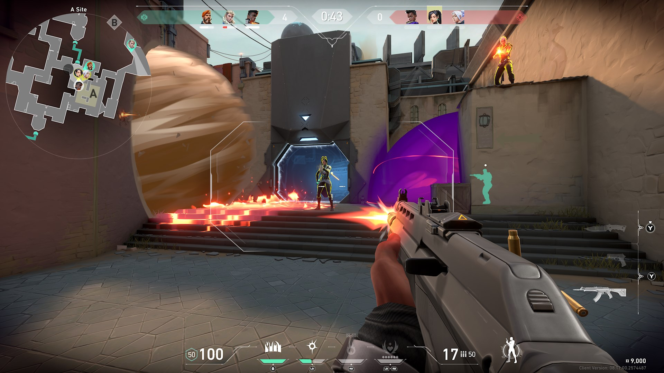
Gameplay Overview
Each match is played between two teams of 5 players.
One team attacks, the other defends.
Objective: Plant and defend the spike or eliminate the enemy
team.
First to win 13 rounds wins the match.

Slide 6
Agents and Abilities
Unique agents with different roles:
Duelists (e.g., Jett, Reyna)
Initiators (e.g., Sova, Fade)
Controllers (e.g., Viper, Omen)
Sentinels (e.g., Sage, Killjoy)

Slide 7
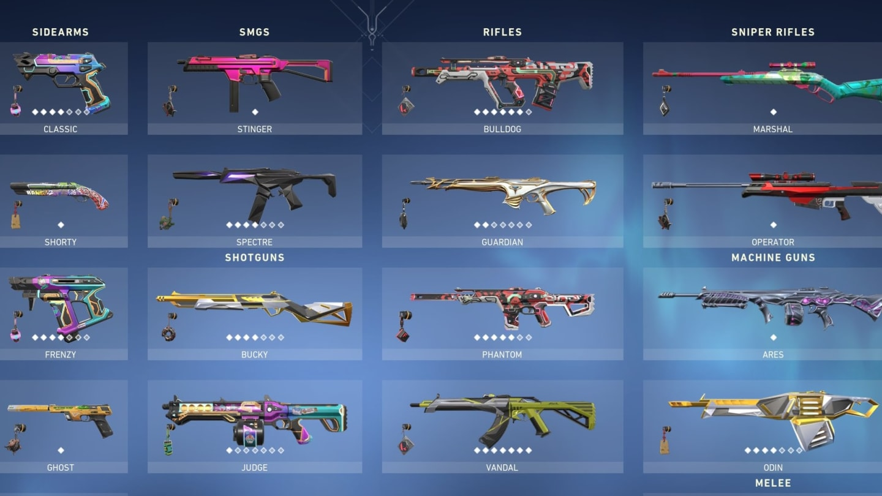
Weapons & Gunplay
Realistic gun mechanics (spray patterns, recoil control)
Popular weapons: Vandal, Phantom, Operator
Importance of aim and precision

Slide 8
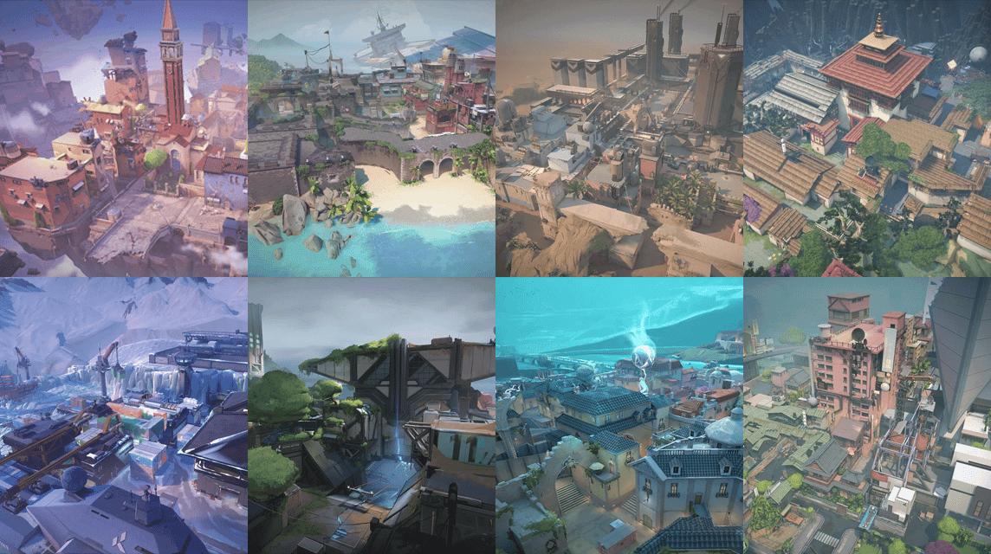
Maps
Custom-built maps designed for balance and strategy
Examples: Bind, Ascent, Haven, Lotus
Each map has unique features (teleporters, doors, etc.)

Slide 9
Why is Valorant So Popular?
Competitive and skill-based
Blend of Counter-Strike gunplay and Overwatch-style abilities
Strong support and constant updates from Riot Games

Slide 10
Conclusion
n conclusion, Valorant Ascension enhances the gaming experience with its innovative features and competitive edge, solidifying its place in the hearts of players around the world.

